Slide 1
Interpretable Machine Learning
XAI

Slide 2


Facilitators
Erica Akanko
Maxwell Owusu
Bioinformatician, West African Centre for Cell Biology of infectious Pathogens
Embedded AI researcher – Palm University

Slide 3
Table of Content
Understanding the concept of interpretability in machine learning
Distinguish between interpretable and black-box models

Slide 4
Table of Content
Explore the difference between global and local explanations
Explore simple techniques for explaining model predictions

Slide 5
Table of Content
Gain hands-on exposure to basic interpretability tools (e.g., feature importance, SHAP/LIME)
Recognize limitations and potential pitfalls of explanations

Slide 6
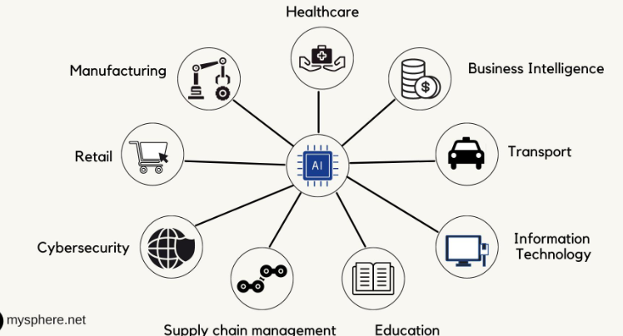
The Scope of AI in daily lives
It is estimated that by the end of 2026, Artificial intelligent will be fundamental component in almost every business operation[1]

Slide 7

Manufacturing / Mining
Notes:
What manufacturing process do we know to adopt full/partial AI capabilities

Slide 8


Education

Slide 9



Health

Slide 10


Global Trade and Logistics

Slide 11

AI Accountability and Responsibility
_{IF}
AI and Robots are moving from Automated Systems to advanced Socially Assisted Systems, …
_{IF}
AI is moving from Assisted Systems to Collaborative Systems (Human collaborators and Interns)
_{IF}
AI taking Autonomous Decisions,…
THEN WHO SHOULD BE HELD…
Accountable?
Liable?
Responsible?
For decisions made either with the help of AI or solely by AI

Slide 12
The Need For AI with Accountability…
If AI takes control of our major decision making processes, then there should be the need for this same AI to take some responsibilities…
BUT HOW??????

Slide 13
How can AI be accountable -
AI must at least interpret and explain their predictions
The need for AI with the Ability to explain Its actions is what we term as ML Interpretability and Explainability
What is ML Interpretability ?

Slide 14

What is ML Interpretability
From The Dark Black Box of ML
To the Crystal Clear Glass Box of ML

Slide 15
ML Black and Glass Boxes
What is ML Black Box
An ML black box is an AI system where inputs and outputs are visible, but the internal decision-making process is opaque, complex, or unknown to users
ML Glass Box
machine learning models that are intrinsically interpretable, meaning their internal logic, structure, and decision-making processes are transparent and can be understood directly by humans

Slide 16

Fundamental Objective of ML Interpretability
Predictions and Actions Must be humanly understandable
There must be insightful justification for a given Predictions in AI interpretability

Slide 17
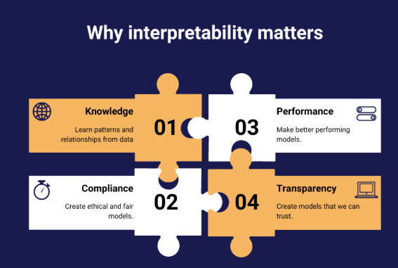
Why ML Interpretability Matters

Slide 18
How ML Interpretability can be achieved
Intrinsic Interpretability
Simple and transparent models
Easy to understand internally
Examples: Decision Trees, Linear Regression

Slide 19
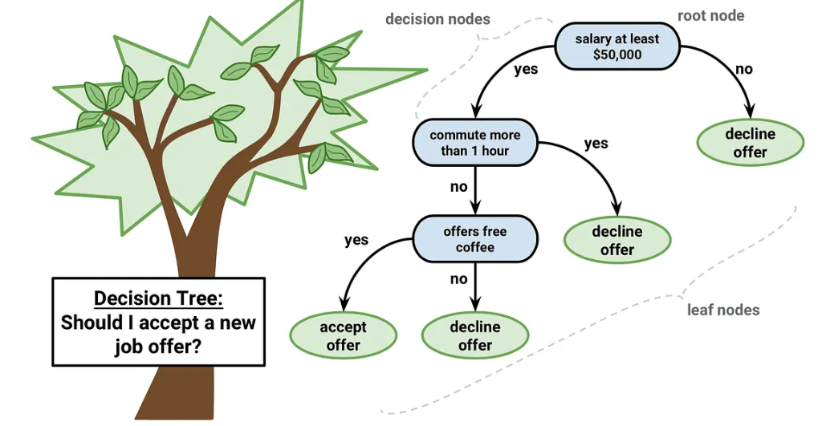
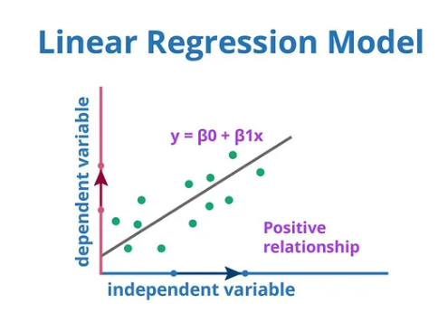
Linear Regression and Decision Tree

Slide 20
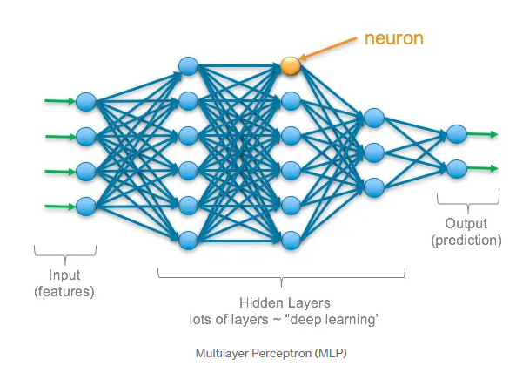
Difficulty in some model interpretabilities.
Some ML models are more complex and has extreme difficulty in interpreting it’s internal workings and results.
Artificial Neural Networks (ANN)

Slide 21
How ML Interpretability can be achieved in Complex ANN
Post-hoc Interpretability
Explains complex (black-box) models
Applied after model training
Examples: SHAP, LIME

Slide 22
Discussion
Can AI enabled medical robot be sued for medical negligence?
Who should be charged for traffic offense?
The driverless car?
The passenger? The owner?
The manufacturer?
Who should be held responsible for losses in forex trading?

Slide 23
Hands-on Demonstration

Slide 24
References
Leading AI Models Revolutionizing Industries in 2026
Linear Regression: The Cornerstone of Predictive Analytics | by Abhay singh | Medium
Decision Tree Algorithm. Demystifying Decision Tree Classifier… | by Abdul4code | GoPenAI
Deep Learning: Overview of Neurons and Activation Functions | by Stacey Ronaghan | Medium

